Slide 1
Climates: Ireland and the Wider World
Chapter
32
Learning outcomes: 1.6

Slide 2
At the end of this chapter, you will be able to:
32.1 Describe the factors affecting global climates.
32.2 Describe the factors affecting local climate.
32.3 Identify and describe different global climates.
32.4 Describe and explain Ireland’s climate.

Slide 3
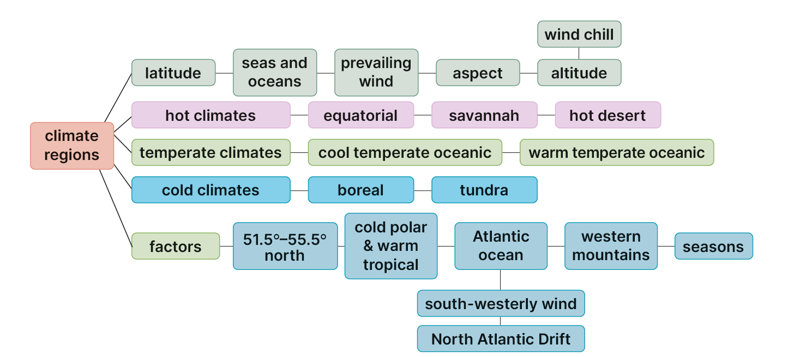
Keyword connections

Slide 4
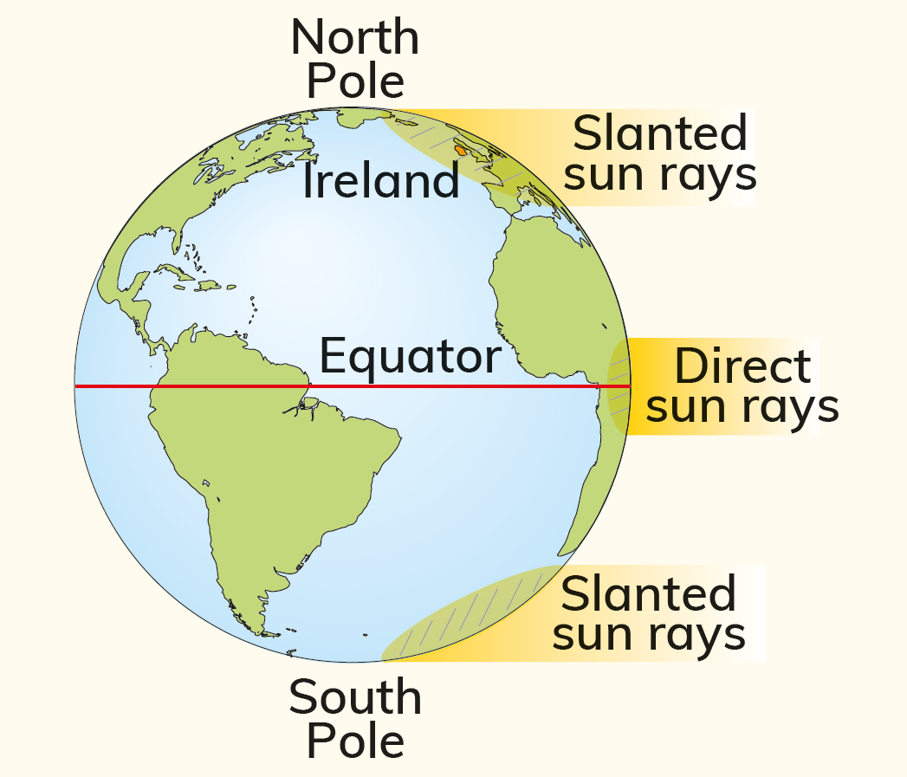
32.1 Describe the factors affecting global climates.
Latitude
Latitude is distance from the equator.
It is described using angles. Ireland is approximately 53° north of the equator.
Latitude affects climate.

Slide 5
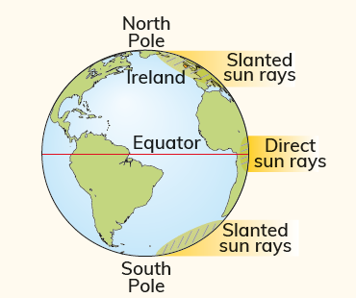
32.1 Describe the factors affecting global climates.
Latitude
At the equator:
Places near the equator receive the most heat:
The sun shines from directly overhead.
The rays of the sun have less distance to travel before they reach the surface of the Earth, so temperatures are hotter here.
At the poles
Places nearer to the poles receive less heat:
The sun shines at an angle, so the sun’s energy is spread more thinly over a wider area than at the equator.
The sun’s energy has to pass through more atmosphere. This means more of the sun’s energy is lost before it reaches the Earth’s surface.

Slide 6
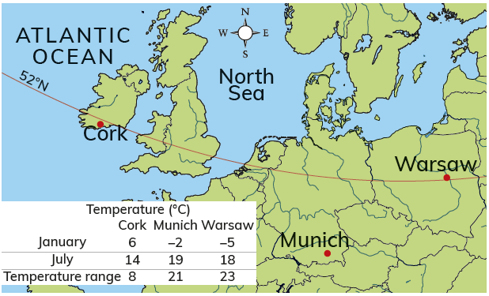
32.1 Describe the factors affecting global climates.
Distance from Seas and Oceans
Land heats up quickly in summer but cools quickly in winter.
The sea heats up slowly in summer and cools slowly in winter.
This means that places near the sea are cooler in summer than places inland.
It also means that places near the sea are warmer in winter than places inland.
Complete the Activity on page 400 of your Textbook

Slide 7
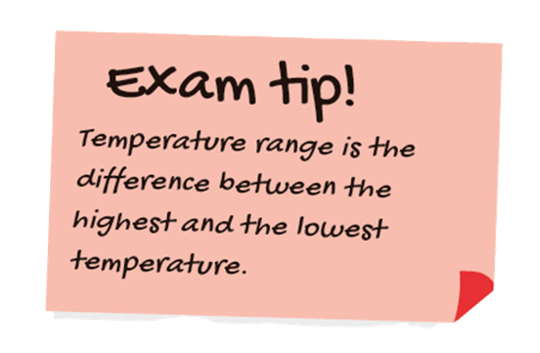
32.1 Describe the factors affecting global climates.
Distance from Seas and Oceans
Cork and Warsaw both lie on the same line of latitude. They should have the same climate.
Cork is located near the sea, however, so it has a smaller temperature range.
Cork’s temperature range is 8°C. Warsaw’s temperature range is 23°C.

Slide 8
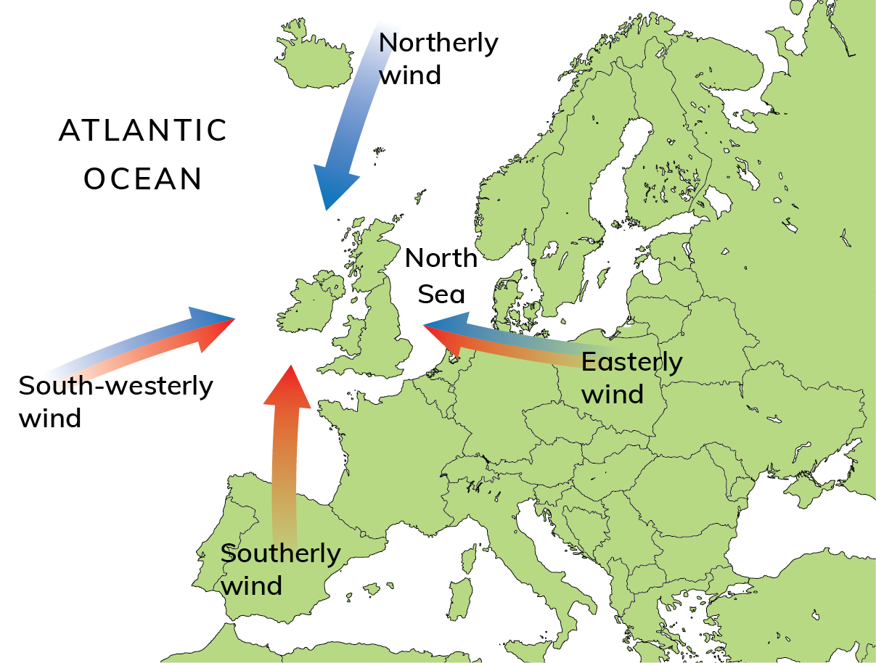
32.1 Describe the factors affecting global climates.
Prevailing Wind
The prevailing wind is the most common wind blowing over a region.
Winds are named after the direction from which they blow.

Slide 9
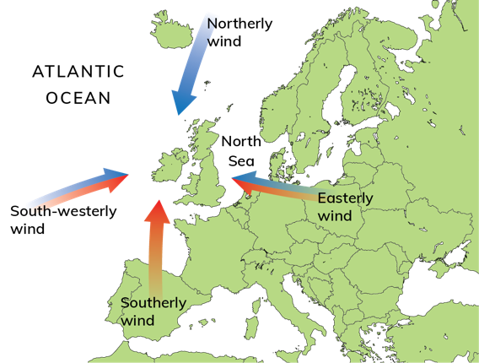
32.1 Describe the factors affecting global climates.
1. Northerly winds come from high latitudes (nearer the poles), so they are cold. They are usually dry winds.
Prevailing Wind
2. South-westerly winds blow in from over the Atlantic. As a result, they are cool in summer and warmer in winter. This means they bring temperate conditions to Ireland. The warm winds absorb moisture as they pass over the Atlantic, so they bring rain.
4. Easterly winds blow in from over Europe. As a result, they are warm in summer as the land over which they travel has heated up. They are cold in winter as the land loses heat quickly. They are usually dry winds. This is because they blow over land so do not absorb moisture.
3. Southerly winds come from lower latitudes (nearer the equator) so they are warm. They can bring precipitation because they cool down and lose moisture when they move from lower to higher latitudes.

Slide 10

32.1 Describe the factors affecting global climates.
1. What is latitude?
2. Why are the poles colder than the equator?
3. Why is the weather milder in Cork than in Warsaw?
4. What is a prevailing wind?
5. What is meant by ‘temperature range’?

Slide 11
32.1 Describe the factors affecting global climates.
Higher-order questions 1
1. What would you expect a climate to be like when you combine latitude and distance from seas and oceans?
2. Ireland sometimes experiences easterly winds around February. What effect would this have on Ireland?
3. If climate was your only consideration, where would you prefer to live – Cork or Warsaw? Explain your answer.

Slide 12
32.1 Describe the factors affecting global climates.
Go to Section 32.1 on page 179 of your Skills Book.

Slide 13
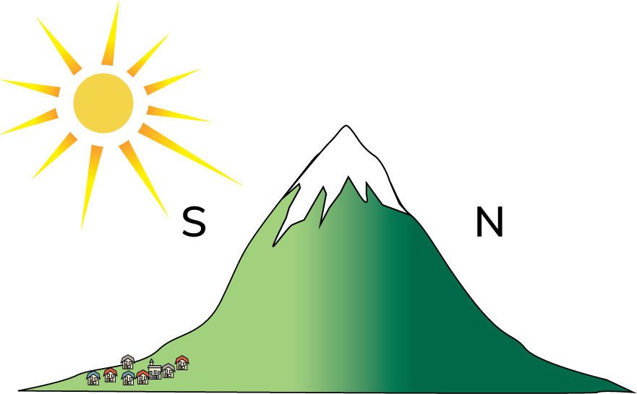
32.2 Describe the factors affecting local climate.
Aspect is the direction in which a slope faces.
In the northern hemisphere, south-facing slopes are warmer than north-facing slopes, as south-facing slopes get the most heat.
The sun sets in the west in the evening.
North-facing slopes get less heat.
North-facing slopes also get cold north-easterly winds.

Slide 14
32.2 Describe the factors affecting local climate.
Altitude is the height of a place above sea level.
The higher its altitude, the colder a place will be.
The top of a mountain is always colder than the base of a mountain.
This is because the air gets thinner as you go higher, so it is less able to hold heat.
Temperatures decrease by 1°C for every 150 m climbed.
Areas at high altitude are also windier, so the temperature is even colder.
This is called the wind-chill factor.

Slide 15

32.2 Describe the factors affecting local climate.
1. What is meant by ‘aspect’?
2. Which would you prefer to live on – a south-facing slope or a north-facing slope? Explain your choice.
3. What is meant by ‘altitude’?
4. If the temperature is 15°C in a lowland area, what temperature is it on top of a mountain 900 m in altitude?
5. What is meant by ‘wind-chill factor’?

Slide 16
32.2 Describe the factors affecting local climate.
Higher-order questions 2
1. Can distance from seas and oceans make higher-altitude climates more mild? Explain your answer.
2. Do north-facing slopes ever receive sunlight?
3. Is there always an absence of settlement on the north side of mountains?

Slide 17
32.2 Describe the factors affecting local climate.
Go to Section 32.2 on page 179 of your Skills Book.

Slide 18
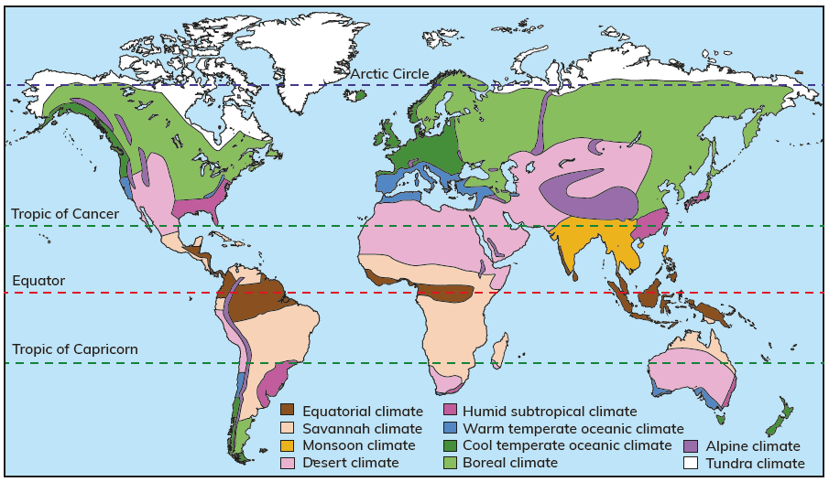
32.3 Identify and describe different global climates.
A natural region is an area that has unique characteristics such as climate, natural vegetation, wildlife and human activity. These characteristics make the region different from other places.

Slide 19
32.3 Identify and describe different global climates.
Cold Climates
 | 1. Tundra | 2. Boreal
Location | Near the poles | Near the poles
Seasons | Two seasons | Two seasons
Weather | Short, cold summers: 5°C on average Long, cold winters: –35°C Wide annual temperature range Rainfall: less than 250 mm per year | Short, cool summers: 10–15 °C Long hours of daylight Long, cold winters: –25 °C Long hours of darkness Rainfall: less than 400 mm per year
Natural vegetation | Little vegetation; heather; mosses; lichens | Coniferous forest called taiga; fir spruce; Scots pine
Wildlife | Polar bears | Arctic foxes
Example | Lapland | Sweden

Slide 20
32.3 Identify and describe different global climates.
 | 1. Warm temperate oceanic (Mediterranean) | 2. Cool temperate oceanic
Location | In mid-latitudes (not too hot or cold) | In mid-latitudes (not too hot or cold)
Seasons | Two seasons | Four seasons
Weather | Hot, dry summers: 30°C on average Mild, moist winters:4–8°C Rainfall: 400–700 mm per year | Moderate climate Warm summers: 15–17°C Mild winters: 4–6 °C Rainfall: 800–2,000 mm per year
Natural vegetation | Evergreen woodland: cork oak, cedar, olive Heather Herbs | Deciduous forests: oak, ash, willow Ferns Mosses
Wildlife | Goats Sheep Wild boar | Red squirrels Deer Badgers
Example | Spain | Ireland
Temperate
Climates

Slide 21
32.3 Identify and describe different global climates.
 | 1. Equatorial | 2. Savannah | 3. Hot desert
Location | Near the equator | Near the equator | Near the equator
Seasons | One season | Two seasons | One season
Weather | Hot temperature all year round: 32 °C on average Rainfall throughout the year – average 2,000 mm per year Humid | Hot temperature all year round: 25–35 °C Average rainfall – 800 mm per year Wet in summer Dry in winter | Very hot temperature all year round: 30–50 °C Low night-time temperatures: 5 °C Low rainfall – around 250 mm per year Periods of drought
Natural vegetation | Rainforests Jungle | Grassland Few trees | Cacti Palm trees
Wildlife | Exotic birds Monkeys Snakes | Lions Giraffes Antelope | Camels Lizards Scorpions
Example | Brazilian rainforest | Angola | Sahara desert
Hot climates

Slide 22

32.3 Identify and describe different global climates.
1. Name two hot climates.
2. Name two temperate climates.
3. Name two cold climates.
4. Why are hot climates located close on the equator?
5. Name Ireland’s climate.

Slide 23
32.3 Identify and describe different global climates.
Higher-order questions 3
1. Why are natural regions not distributed in neat bands around the world? In making your comparison, refer to the map of world climates on page 403 of your Textbook.
2. Why is there a warm-temperate climate and a cold-temperate climate?
3. Compare the map on page 403 of your Textbook with other world maps in your Textbook. What patterns can you identify?

Slide 24
32.3 Identify and describe different global climates.
Go to Section 32.3 on page 180 of your Skills Book.

Slide 25
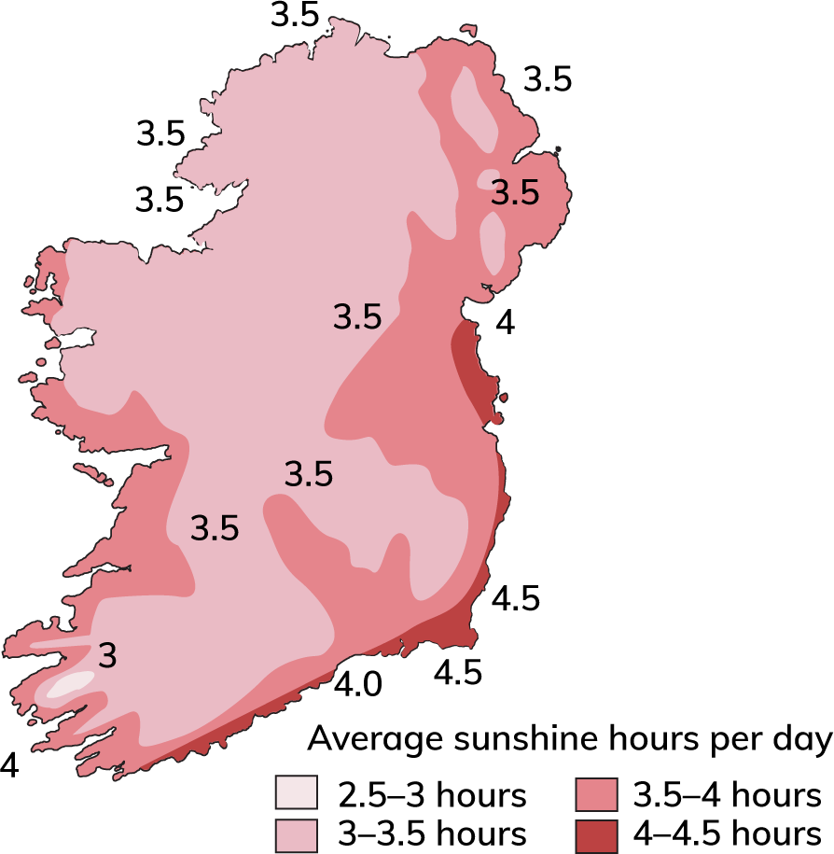
32.4 Describe and explain Ireland’s climate.
Factors Influencing Ireland’s Climate
Latitude
Ireland is located between 51.5° and 55.5° north.
It has a cool, temperate, oceanic climate.
It is not as hot as places closer to the equator (0°), but it is not as cold as places near the poles (90°).
The south-east of Ireland is closer to the equator than the north of Ireland. The south-east receives more sunshine than any other part of Ireland, and is referred to as the ‘sunny south-east’.

Slide 26
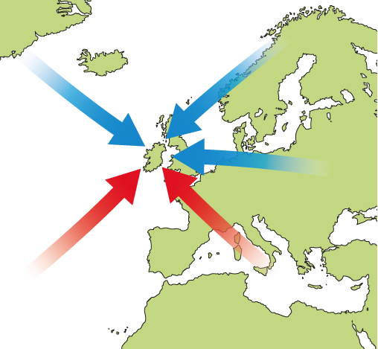
32.4 Describe and explain Ireland’s climate.
Factors Influencing Ireland’s Climate
Air Masses
Ireland’s latitude means it lies on the path of several air masses that affect its climate.
The characteristics of air masses are controlled by whether they pass over land or sea.

Slide 27
32.4 Describe and explain Ireland’s climate.
Factors Influencing Ireland’s Climate
Air masses
Arctic air masses originate in the North Pole and bring cold weather conditions.
Ireland’s weather and climate are especially marked by depressions, which occur when cold, polar air masses from the north meet warm, tropical air masses from the south.
Polar air masses originate in the poles
and bring cold weather conditions.
Continental air masses originate over continents, such as Europe, and bring dry, cold
weather.
Maritime air masses pass over oceans and bring wet weather conditions.
Tropical air masses originate in tropical regions and bring warm weather conditions.

Slide 28
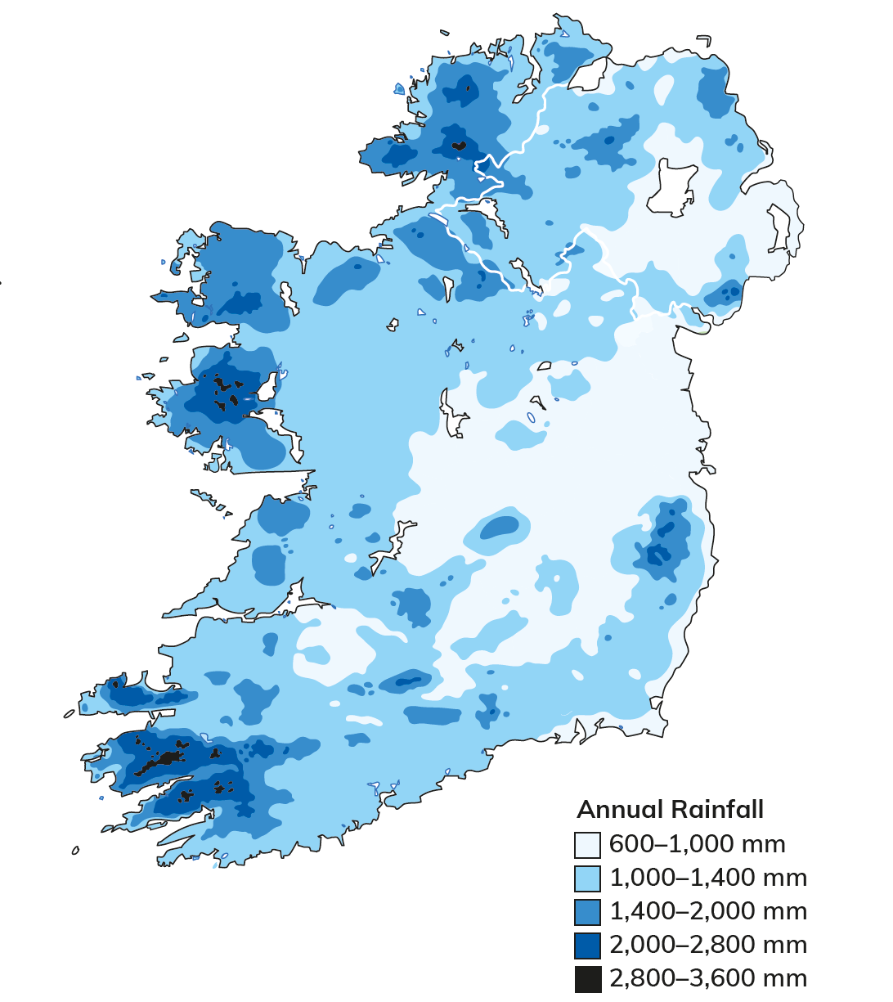
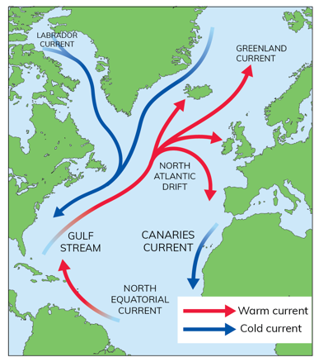
32.4 Describe and explain Ireland’s climate.
Factors Influencing Ireland’s Climate
Ocean currents
Ireland’s climate is affected by ocean currents.
The Gulf Stream is a warm ocean current that flows out of the Gulf of Mexico and travels north. As it moves into the Atlantic, it becomes the North Atlantic Drift.
This current keeps Ireland’s western seaports free of ice in winter.
The North Atlantic Drift also warms the air above it. This creates mild onshore winds on Ireland’s west coast.
This means that Ireland has an oceanic climate.

Slide 29
32.4 Describe and explain Ireland’s climate.
Factors Influencing Ireland’s Climate
Prevailing winds
Ireland’s prevailing winds are the south-westerlies.
These winds:
Come from warmer latitudes
Blow over the North Atlantic Drift.
This means that they pick up moisture as they blow towards Ireland.
This creates relief rainfall.
The mountains receive more rainfall than any other part of Ireland.
By the time air from the Atlantic moves across Ireland, it has lost much of its moisture, so the east coast of Ireland is drier than the west.

Slide 30
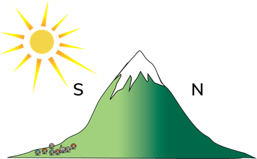
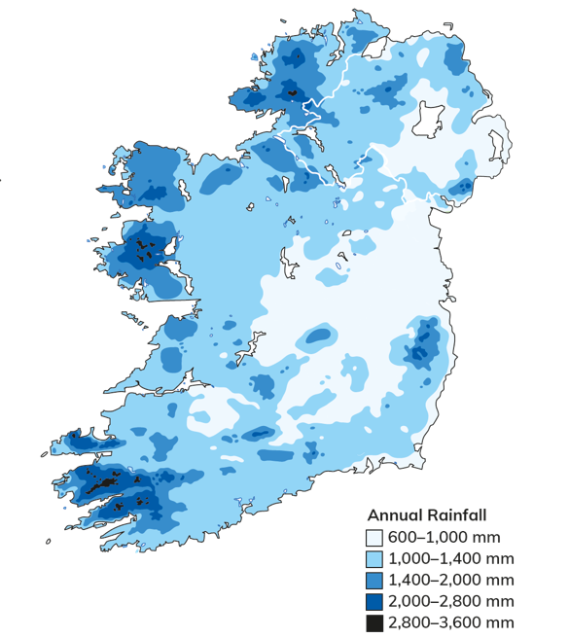
32.4 Describe and explain Ireland’s climate.
Factors Influencing Ireland’s Climate
Altitude
Ireland is saucer-shaped.
There is a low central plain surrounded by a rim of mountains.
Mountains are highest in the south-west of Ireland, and these receive the most rain.
Lowland areas such as the Central Plain receive less rain.
Altitude also affects temperature. Temperatures decrease by 1°C for every 150 m altitude. A mountain that is 450 m above sea level is 3°C cooler than the temperatures at sea level.
Upland areas, particular in the north of Ireland, are colder than lowland areas.

Slide 31
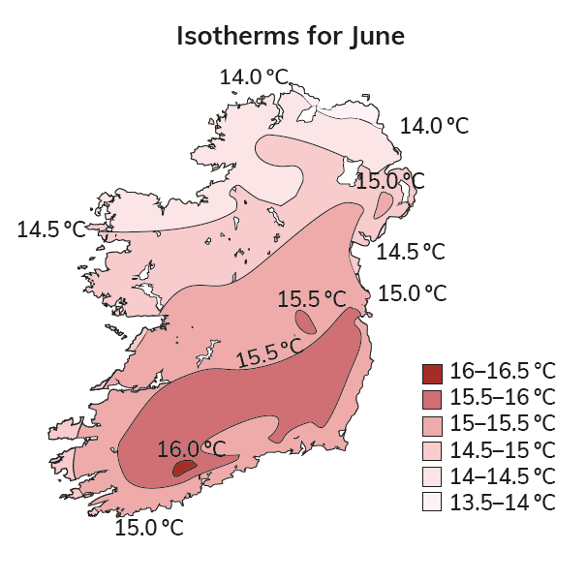
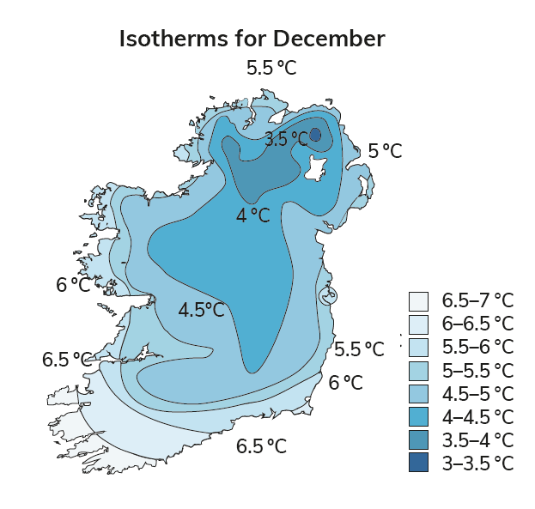
32.4 Describe and explain Ireland’s climate.
Factors Influencing Ireland’s Climate
Distance from Seas and Oceans
Ireland is an island facing the Atlantic Ocean.
Seas warm up more slowly in summer. This means Ireland’s coast is cool in summer (10°C) compared to inland areas (16°C).
In winter, the seas lose heat slowly. This means coastal areas are warmer in winter (10°C) than inland areas (5°C).
This means that Ireland has a temperate climate – not too hot, not too cold.

Slide 32
32.4 Describe and explain Ireland’s climate.
Factors Influencing Ireland’s Climate
Time of Year/Seasons
In winter, the combination of:
Ireland’s location (latitude)
Prevailing winds
means Ireland receives many rain-bearing depressions.
In summer, these move north, and so Ireland gets more good weather.

Slide 33

32.4 Describe and explain Ireland’s climate.
1. What is a maritime air mass?
2. What is Ireland’s prevailing wind?
3. What keeps the bays on Ireland’s west coast ice-free in winter?
4. Why does the west of Ireland receive more rainfall than the east?
5. Why is Wexford sunnier than west Cork?

Slide 34
32.4 Describe and explain Ireland’s climate.
Higher-order questions 3
1. Where in Ireland do you think flood prediction would be most important?
2. If you had to choose a holiday location in Ireland based on climate, where would you choose?
3. Compare the maps of Ireland’s climate with the map on page 246 of your Textbook. What patterns do you notice?

Slide 35
32.4 Describe and explain Ireland’s climate.
Go to Section 32.4 on page 181 of your Skills Book.

Slide 36
Assess your progress
Go to page 184 of your Skills Book and assess your progress.
32.1 Describe the factors affecting global climates.
32.2 Describe the factors affecting local climate.
32.3 Identify and describe different global climates.
32.4 Describe and explain Ireland’s climate.
Identify any gaps in your learning. Use the Rapid Revision on page 409 of your Textbook to jog your memory.

